Slide 1

DATA SCIENCE
Prof. Jean Paul Barddal

Slide 2
CORRELATIONS

Slide 3
Variables that are related to one another
Correlation analysis is a way to analize the relationship between two or more variables. The goal is to quantify and assess whether:
The relation is direct or inverse;
Strong or weak.
Important: correlation does NOT imply causation.

Slide 4
Example
Month | Production (l) | Total cost (R$)
Jan | 20200 | 19000
Fev | 16700 | 17000
Mar | 14800 | 14000
Abr | 16000 | 15000
Mai | 12100 | 14000
Jun | 13000 | 15000
Jul | 11600 | 13000
Ago | 15500 | 16000
Set | 18900 | 18000
Out | 20000 | 19000
Nov | 22500 | 20000
Dez | 23000 | 21000
How can we determine whether production is correlated with the cost?

Slide 5
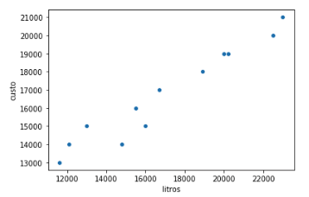
Scatterplot
Points in a cartesian system, which allow a quick overview of the data and potential correlation

Slide 6
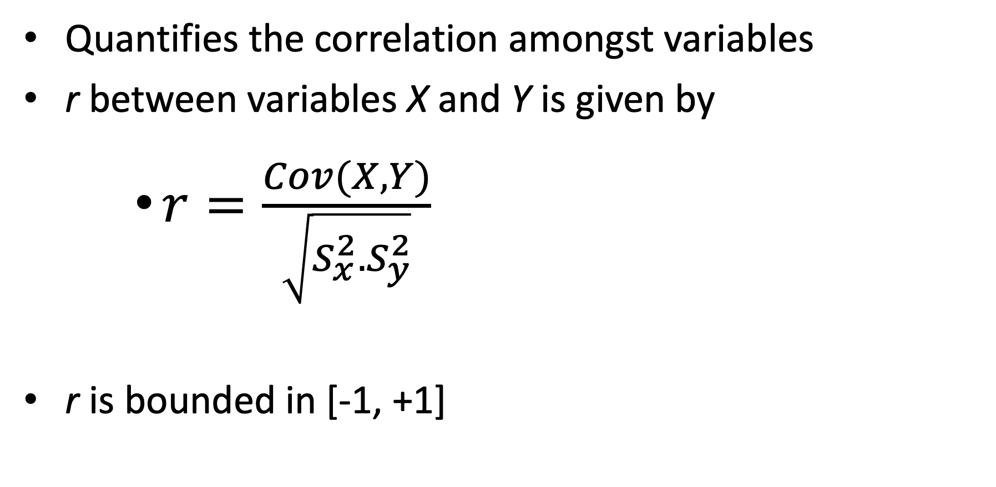
Pearson correlation
Quantifies the correlation amongst variables
r between variables X and Y is given by
$r=\frac{Cov(X,Y)}{\sqrt{S_{x}^{2}.S_{y}^{2}}}$
r is bounded in [-1, +1]

Slide 7
Understanding Pearson’s coefficient
r
-1
0
+1
CORRELATION
negative
strong
negative
mild
negative
weak
positive
weak
positive
mild
positive
strong
(DIRECTION)
(STRENGTH)
NEGATIVE PERFECT
NULL, ABSENT
POSITIVE PERFECT

Slide 8
Visual analysis
PERFECT
STRONG
WEAK
POSITIVE
NEGATIVE

Slide 9
Visual analysis
NULL OR ABSENT CORRELATION

Slide 10
(not so) formal definition
|r| (modulus) | Interpretation
|r| < 0.4 | Weak correlation
0.4 <=|r| < 0.7 | Mild correlation
0.7 <= |r| | Strong correlation
Note that there is no consensus on these threshold.
Different areas assume different values

Slide 11
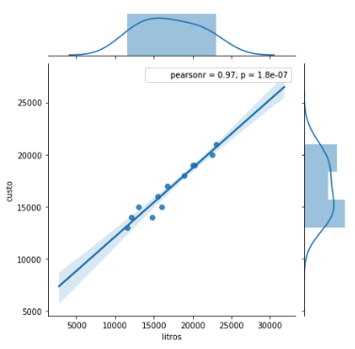
Previous example
Let’s code the previous example of production amount and costs

Slide 12
SPEARMAN’s CORRELATION

Slide 13
Spearman’s correlation
Should be used when
Normality assumptions are not met, or
We have ordinal data
Spearman’s 𝜌 (rhô)
Elements are sorted from the most positive to the most negative
𝜌 is computed using Pearson’s equation, taking into account the ranking of each observation
Variáveis categóricas, mas com ordem de importância entre seus valores

Slide 14
(COR-)RELATION BETWEEN CATEGORICAL VARIABLES

Slide 15
Cross-tabulating
A simple approach to check the behavior of categorical variables is to use cross-tables (contingency tables)
Using pd.crosstab and heatmaps allow us to quickly identify interesting behavior in data

Slide 16
Example
Let’s analyze an example using the titanic dataset

Slide 17
MULTICOLINEARITY

Slide 18
Multicolinearity
Problem that arises when multiple variables are correlated to one another
If we use all of them when creating machine learning models, it will be biased towards the same information
Some exceptions exist, e.g., Random Forest
Variable Inflation Factor (VIF)
Determines how explained a variable is given other covariates

Slide 19
Variable Inflation Factor
VIF can be computed as follows:
VIF = 1/(1-R²)
VIF starts at 1 and has no limit
VIF=1 means that there is no correlation between this variable and other variables
VIF higher than 5 usually depicts multicollinearity
VIF should be used iteratively: Compute VIF, remove the variable with the highest VIF, stop if no VIF is above 5

Slide 20
Example
Let’s analyze multicollinearity in a sample of a familiar dataset

Slide 21
CORRELATION AND CAUSATION

Slide 22
Correlation and causation
Several times, we will observe a correlation and assume that one variable is leading the other
This may be true, but not necessarily

Slide 23
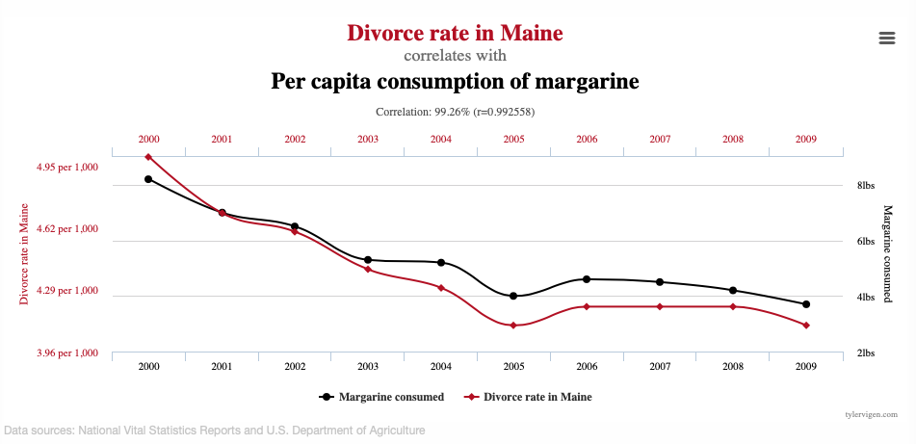
Eating margarine is bad for your marriage?

Slide 24
Eating more cheese increases our chances in dying tangled in our bedsheets?

Slide 25
More examples: Spurious Correlations
https://www.tylervigen.com/spurious-correlations

Slide 26
PROJECT TIME Take the remainder of today’s lecture to continue your project

